Slide 1
Research Platform for Custom Memory Cube
Yu Zou
Vinayak Deshpande
Peter Harduvel
Dr. Herman Lam
Assoc. Professor of ECE
University of Florida

Slide 2
Outline
Review & overview
Notional CMC architecture
Performance measurements on Merlin board
Mapping notional CMC to Merlin board
Simplified CMC-to-Merlin mapping
Validation of performance measurment
Validation of PERFMON code
Validation of performance measurement
Bloom filter HT implementations
Spell checker
Content-based deep packet inspection (longest string match)
Sorting HT implementaitons
Going forward
* DRE: Data rearrangement/reordering engine ** CMC Computational Memory Cube

Slide 3
Notional CMC Architecture*
Based on Nair et al.* : an HMC with a user-programmable logic layer
A, B, C, D, and : performance-measurement points of interest
* Nair, R., et al. "Active Memory Cube: A processing-in-memory architecture for exascale systems.“ IBM Journal of Res. & Development 59.2/3 (2015): 17-1.

Slide 4
DRE* Prototype on CMC Architecture
VB3
VB2
VB3
VB1
View buffer (VB) can be set up on host (design option 1), inside the HMC (design option 2) or inside CMC logic (design option 3)
* DRE: Data Reordering/Rearrangement Engine Lawrence Livermore Nat. Labs

Slide 5
Performance Measurement on Merlin Board
CMC platform on Merlin board
*
Instrumented Merlin infrastructure with hardware performance monitors
A’, B’, C’, D’, M1, M2, M3, M4, M5, and E’
Progress: Able to measure all listed parameters except:
M4, M5: Exploring with help from Convey
E’: Exploring with help with Micron under NDA
VB*: View Buffer

Slide 6
Mapping Notional CMC onto Merlin Board
Merlin board
Case study: model of a notional CMC
Simplifying assumption:
For this model, this part of CMC is assumed to have an HMC architecture

Slide 7
Model of CMC-to-Merlin Mapping
Model of notional CMC
CMC platform on Merlin board
Latency A = ctrl signal transfer time B + latency C + result transfer time B
Ctrl signal transfer time B : time to transfer control signals between host and CMC
Data transfer time B: time for host access to obtain result (e.g., transfer from view buffer)
Latency C = delay TSV* + latency C’ – delay D’minusE’
Delay D’minusE’ = latency D’ – latency E’
* delay TSV= between DRE core and switch, time to transfer a request +
time to transfer response of that request
Latency: round-trip delay from input into a point in the system to desired outcome

Slide 8
Overlapping Memory Access: read/write ops
Observation: M1, M2, M3, (M4, M5, E’) have no significant difference

Slide 9
Overlapping Memory Access: DRE ops
Observation: M1, M2, M3, (M4, M5, E’) again have no significant difference
For overlapping memory access, discrepancy between M1, M2, M3, (M4, M5, E’) is hidden by “pipeline effect”
Thus, a simplified CMC mapping can be used

Slide 10
Outline
Review & overview
Notional CMC architecture
Performance measurements on Merlin board
Mapping notional CMC to Merlin board
Simplified CMC-to-Merlin mapping
Validation of performance measurment
Validation of PERFMON code
Validation of performance measurement
Bloom filter HT implementations
Spell checker
Content-based deep packet inspection (longest string match)
Sorting HT implementaitons
Going forward
* DRE: Data rearrangement/reordering engine ** CMC Computational Memory Cube

Slide 11
Simplified Notional CMC Modeling
For pipelined overlapping memory operations, estimate:
M1 = M2 = M3 = M4 = M5 = E’
Model of notional CMC
CMC platform on Merlin board
Latency A = ctrl signal transfer time B + latency C + result transfer time B
Ctrl signal transfer time B : time to transfer control signals between host and CMC
Data transfer time B: time for host access to obtain result (e.g., transfer from view buffer)
Latency C = latency C’ – delay D’minusE’ + delay TSV*
Delay D’minusE’ = latency D’ – latency E’
Latency: round-trip delay from input into a point in the system to desired outcome

Slide 12
Simplified Notional CMC Modeling
For pipelined overlapping memory operations, estimate:
M1 = M2 = M3 = M4 = M5 = E’
Model of notional CMC
CMC platform on Merlin board
Latency A = ctrl signal transfer time B + latency C + result transfer time B
Ctrl signal transfer time B : time to transfer control signals between host and CMC
Data transfer time B: time for host access to obtain result (e.g., transfer from view buffer)
Latency C = latency C’ + delay TSV*
Latency: round-trip delay from input into a point in the system to desired outcome

Slide 13
Outline
Review & overview
Notional CMC architecture
Performance measurements on Merlin board
Mapping notional CMC to Merlin board
Simplified CMC-to-Merlin mapping
Validation of performance measurment
Validation of PERFMON code
Validation of performance measurement
Bloom filter HT implementations
Spell checker
Content-based deep packet inspection (longest string match)
Sorting HT implementaitons
Going forward
* DRE: Data rearrangement/reordering engine ** CMC Computational Memory Cube

Slide 14
Validation of PERFMON
M1, M2, M3 are measured in PERFMON
PERFMON – hardware (Verilog) monitor designed by Convey, modified by CHREC
M4, M5, E’ are not measured in PERFMON
In overlapping memory access, we observed: M1 = M2 = M3 = M4 = M5 = E’
To validate M1, M2, M3 are accurately measured in PERFMON

Slide 15
Validation of PERFMON
Progress:
Setting up a Merlin board RTL simulation with help from Convey
Validating reported latency from PERFMON in ModelSim

Slide 16
Validation of Measurement
Measurement on Merlin board
overlapping memory request:
Measured on Merlin board: D’=M1=M2=M3
Hypothesis: M4 = M4 = E’ = M1
Collect memory trace at D’
Input memory trace to simulator’s host
Expect: M5 (= E’) = C = E (from HMC simulator)
Simulation on HMC Simulator (from Micron)

Slide 17
Validation of Measurement
Progress

Slide 18
Outline
Review & overview
Notional CMC architecture
Performance measurements on Merlin board
Mapping notional CMC to Merlin board
Simplified CMC-to-Merlin mapping
Validation of performance measurment
Validation of PERFMON code
Validation of performance measurement
Bloom filter HT implementations
Spell checker
Content-based deep packet inspection (longest string match)
Sorting HT implementaitons
Going forward
* DRE: Data rearrangement/reordering engine ** CMC Computational Memory Cube

Slide 19
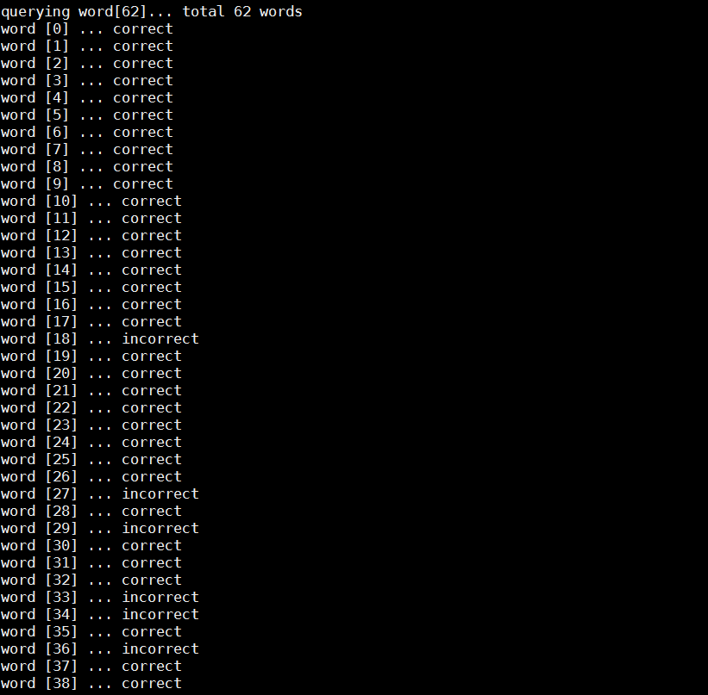
Bloom Filter HT Implementation
First demo: spell checker
Population phase: Use a dictionary as a database to set bloom filter
Probe phase: When a new word is input, bloom filter checks the existence of this word in the dictionary. If doesn’t exist, it’s reported as a wrong spelling.

Slide 20
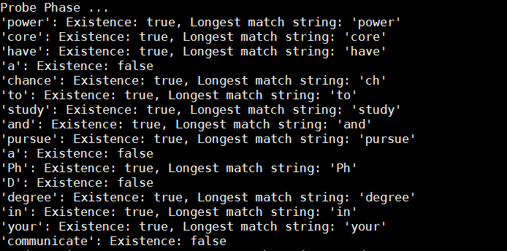
Bloom Filter HT Implementation
Second demo: content-based deep packet inspection (longest string matching)
Population phase: Use a group of different-length sensitive words to set bloom filter
Probe phase: When a packet is input, bloom filter searches the longest matching string in the packet, reports it if any.
Utilized all 16 HT units

Slide 21
Sorting HT Implementation

Slide 22
Outline
Review & overview
Notional CMC architecture
Performance measurements on Merlin board
Mapping notional CMC to Merlin board
Simplified CMC-to-Merlin mapping
Validation of performance measurment
Validation of PERFMON code
Validation of performance measurement
Bloom filter HT implementations
Spell checker
Content-based deep packet inspection (longest string match)
Sorting HT implementaitons
Going forward
* DRE: Data rearrangement/reordering engine ** CMC Computational Memory Cube

Slide 23
Going Forward
F1
Platform development
Complete validation of CMC platform
Complete development & instrumentation of CMC platform
Develop library for customization of notional CMC architecture under study
Create user-friendly CMC API
Explore CMC apps using HT
Case studies to explore
Notional CMC architectures
CMC apps, including:
Data Reordering/Rearrangement Engine, sorting algorithms, bloom filter
Lessons learned, including:
Characteristics of CMC-amenable apps
How to re-factor algorithms to become CMC-amenable
Share code and lessons with LPS
Visit LPS

